Slide 1

Analyzing the Stability of Compact Finite Difference Schemes for Use in Binary Black Hole Simulations
Nathanael Garey, Eric Hirschmann, David Neilsen, William Black, James Bleazard, Luke Papenfuss, Andrew Carroll

Slide 2
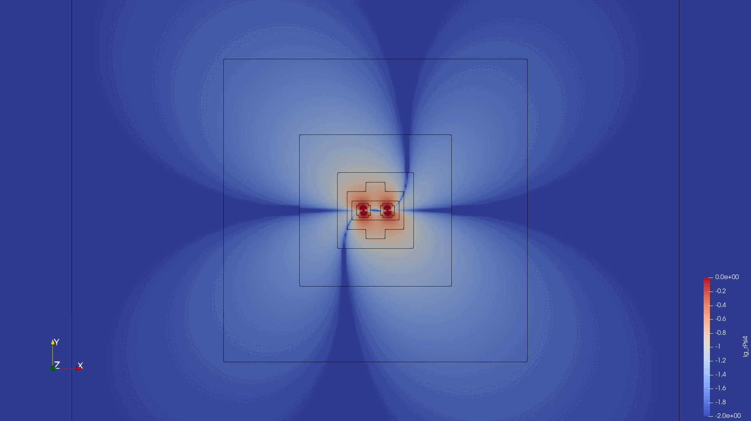
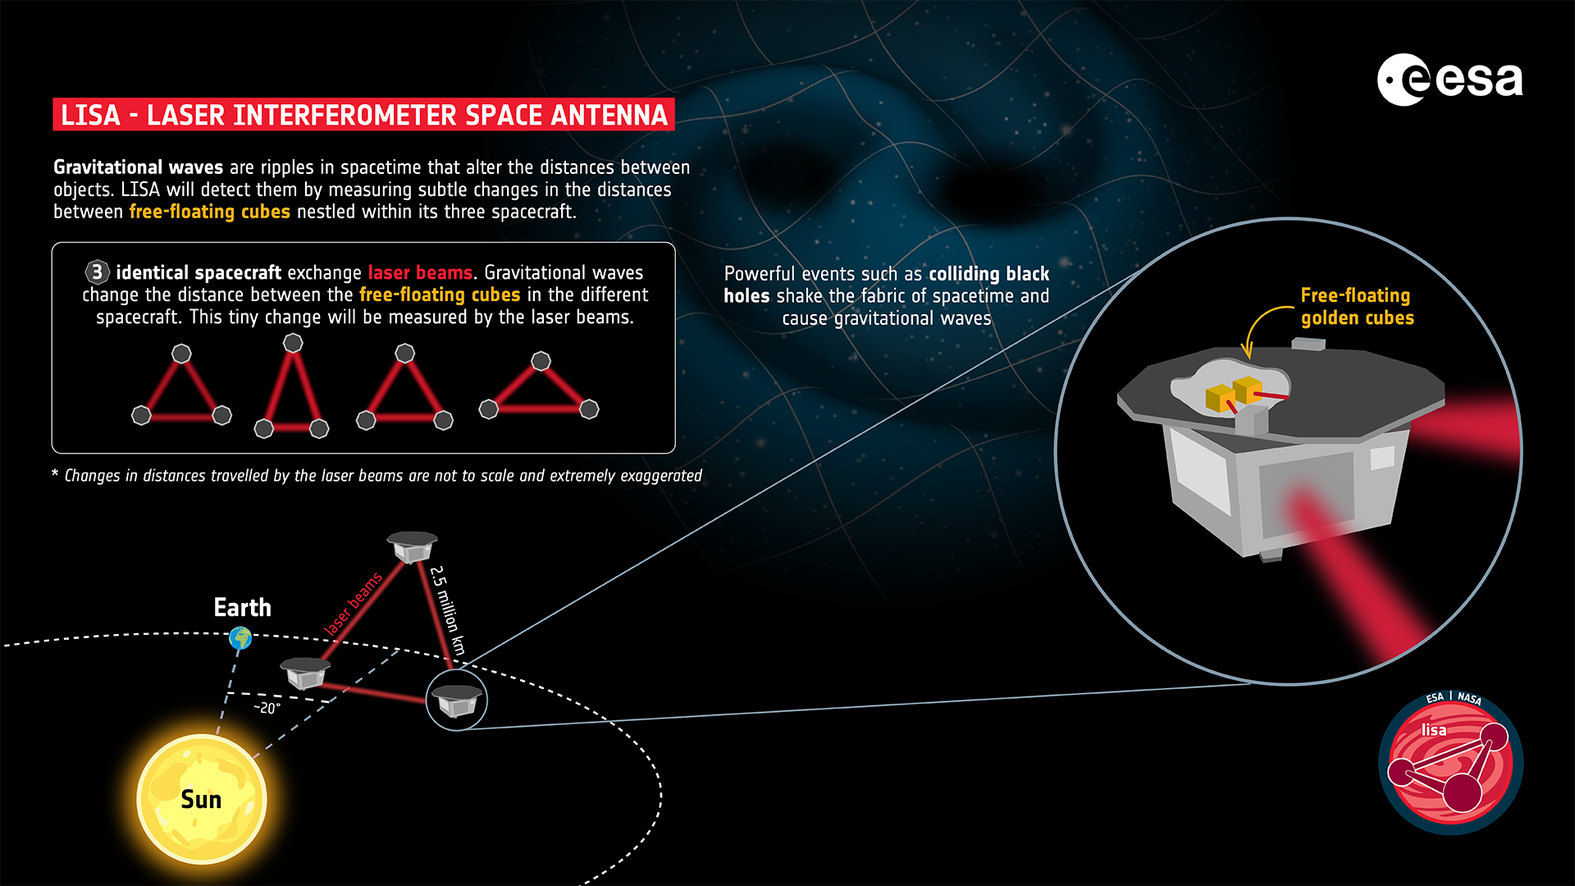
Goals and Motivation
Fast and accurate black hole merger simulations and waveforms are needed with new GW detectors
Additional factors (high mass ratio, spin, eccentricity) increase computational costs
Many future improvements are still possible and waiting to be discovered

Slide 3
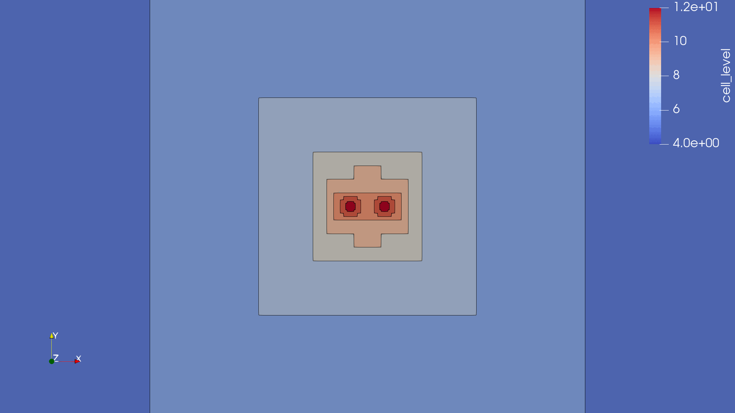
Dendro-GR
Performs binary black hole simulations with Wavelet Adaptive Mesh Refinement (WAMR)
Less refinement is needed in the grid where information hasn’t yet propagated
We are implementing our methods with hope to improve accuracy and communication between processing units

Slide 4
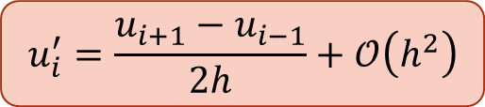
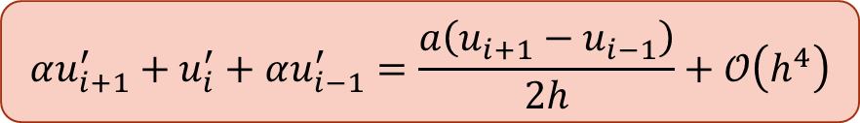
Explicit vs. Compact Schemes
Explicit schemes can be derived from the limit definition of the derivative
Compact Finite Difference (CFD) schemes can be derived from a Taylor expansion
CFD schemes can achieve higher accuracy with less points
CFD schemes come with an additional computational cost of matrix inversion, but fast inversion methods exist
Our current efforts focus on finding stable and highly accurate CFD schemes
Explicit Scheme
Implicit/Compact Scheme
$$u_{i}^{′}=\frac{u_{i+1}−u_{i−1}}{2h}+𝒪\left(h^{2}\right)$$
$$αu_{i+1}^{′}+u_{i}^{′}+αu_{i−1}^{′}=\frac{a\left(u_{i+1}−u_{i−1}\right)}{2h}+𝒪\left(h^{4}\right)$$

Slide 5
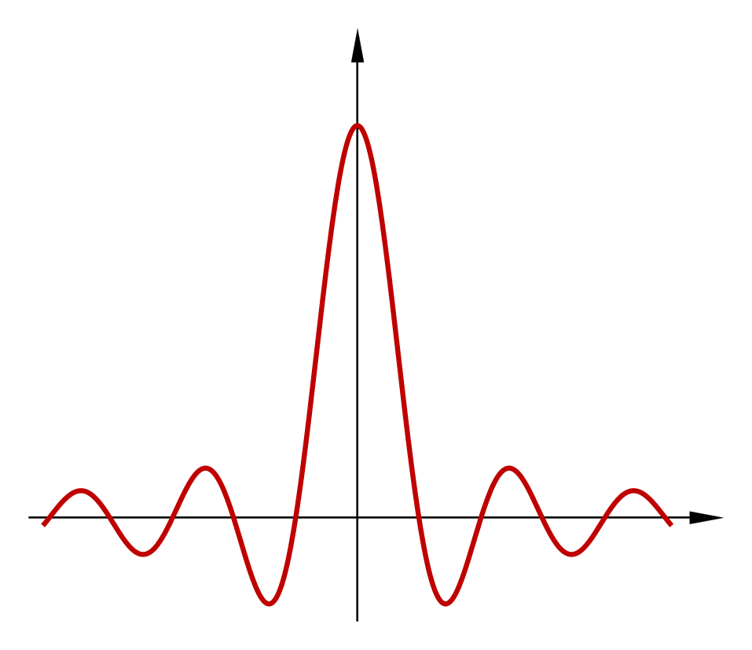
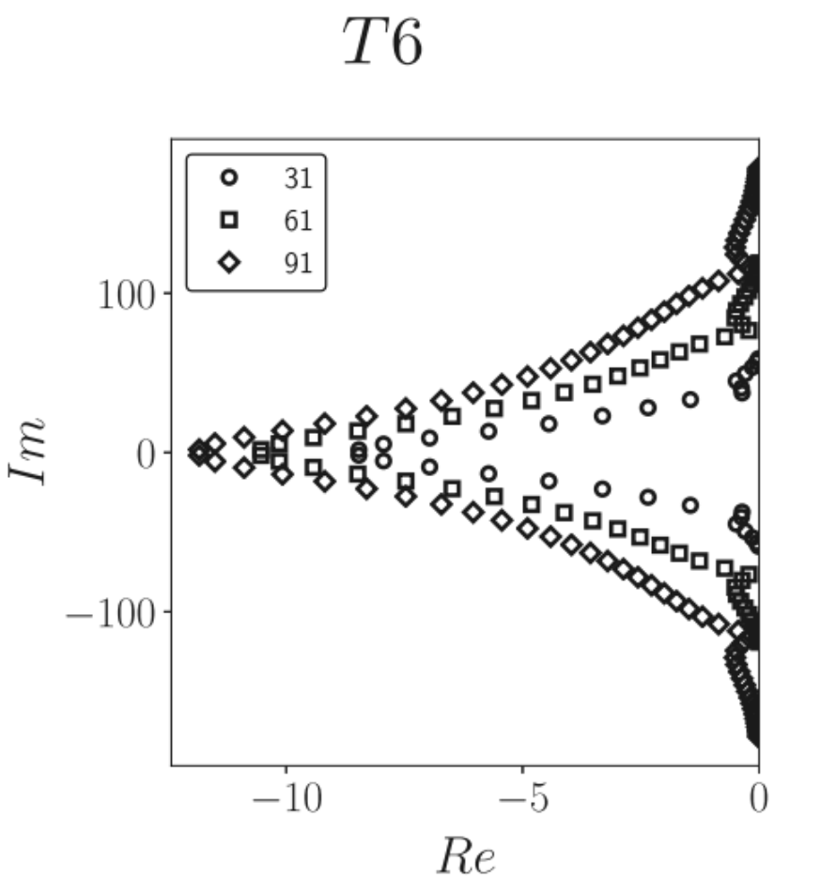
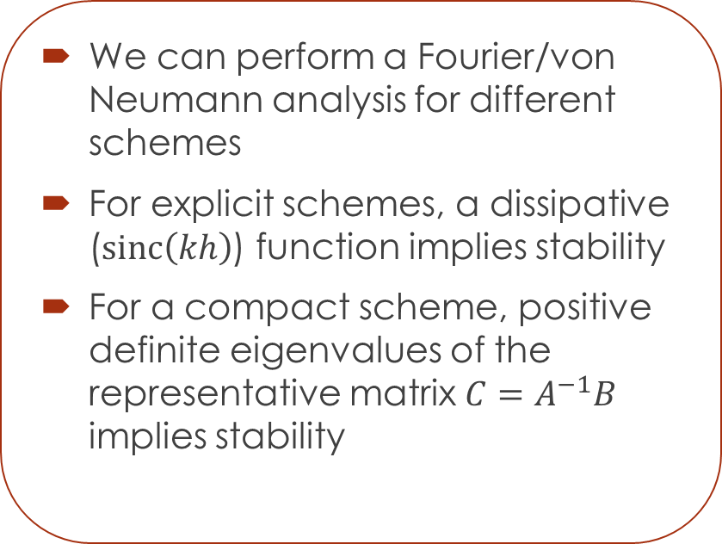
Analytic Approach to Stability
We can perform a Fourier/von Neumann analysis for different schemes
For explicit schemes, a dissipative ($sinc\left(kh\right)$) function implies stability
For a compact scheme, positive definite eigenvalues of the representative matrix $C=A^{−1}B$ implies stability
Brady and Livescu (2018)

Slide 6
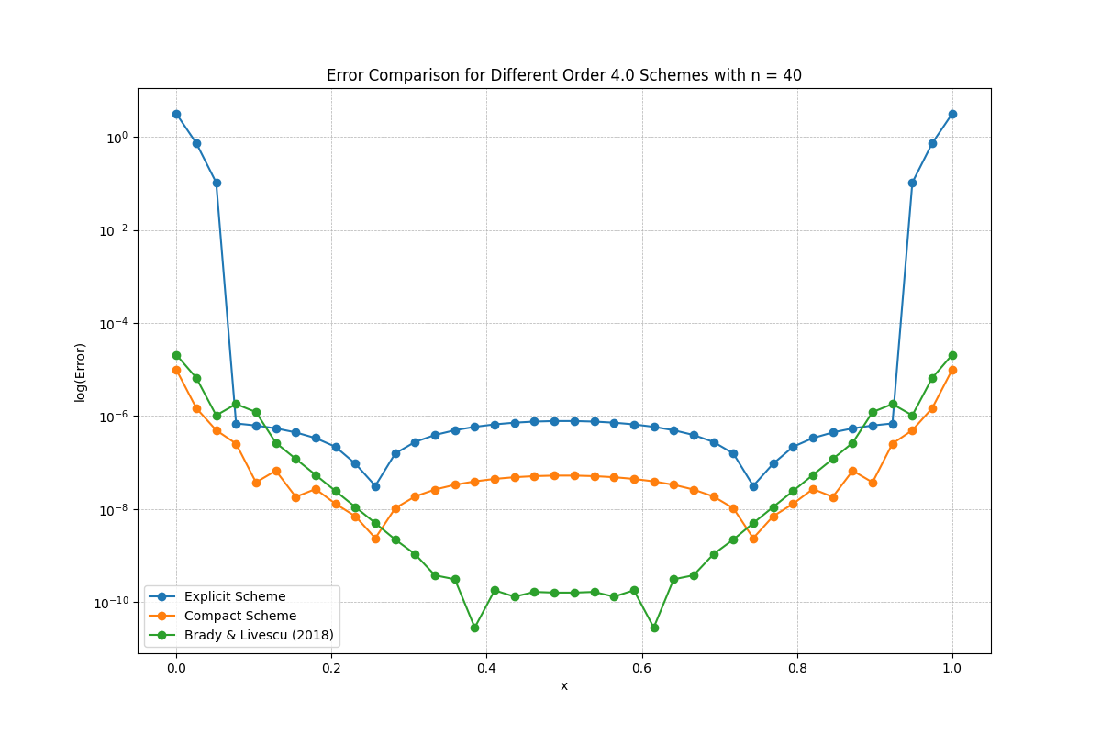
Accuracy Improvement of Compact Schemes

Slide 7
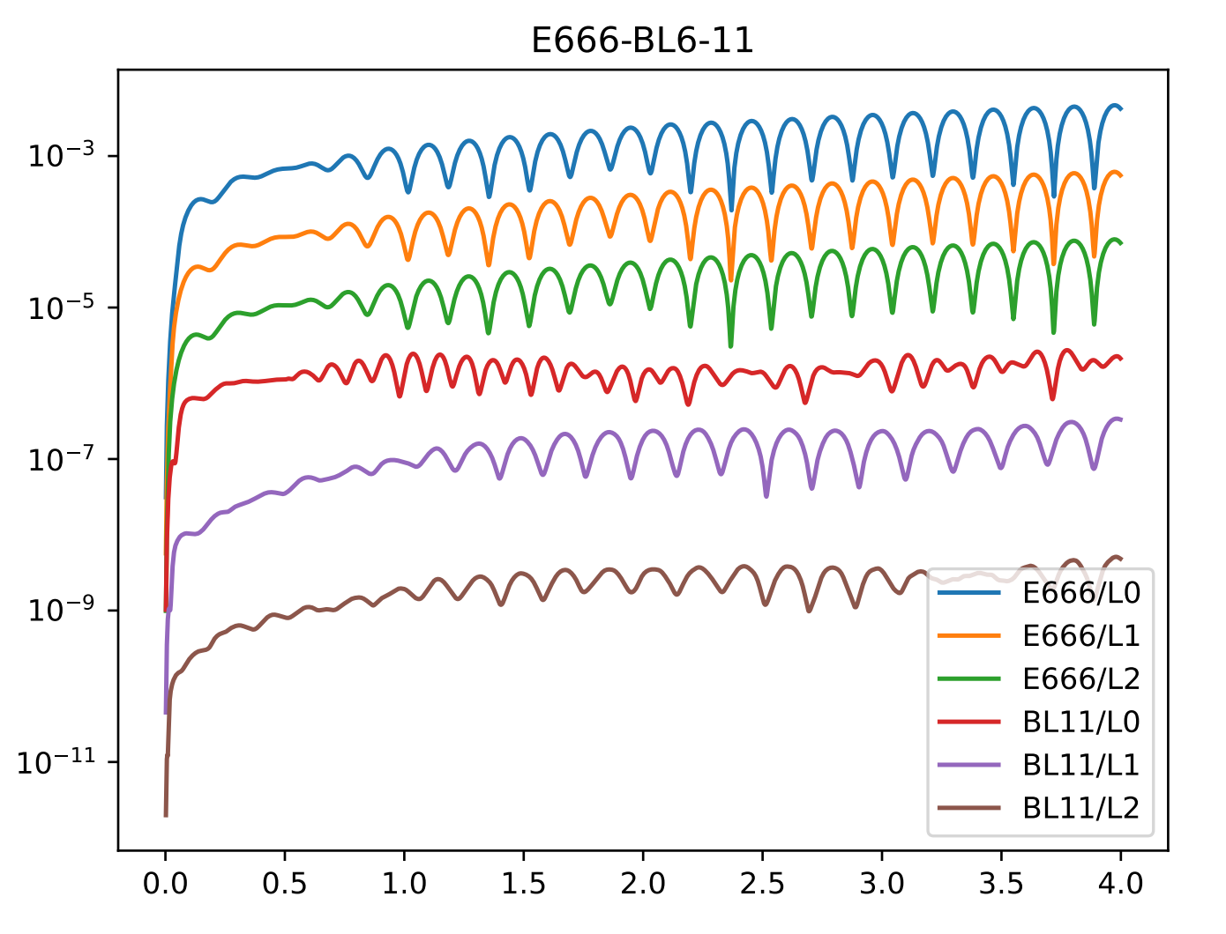
Time Stability of Compact Schemes

Slide 8
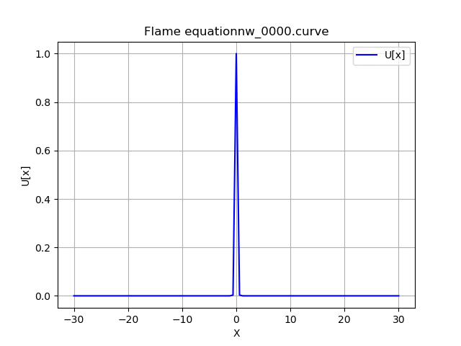
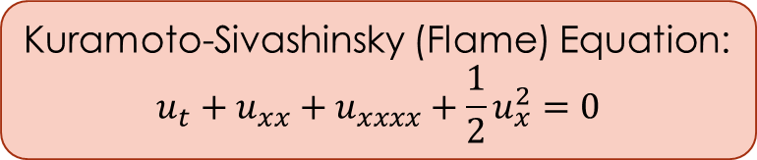
Nonlinear Stability of Compact Schemes
Kuramoto-Sivashinsky (Flame) Equation:
$$u_{t}+u_{xx}+u_{xxxx}+\frac{1}{2}u_{x}^{2}=0$$

Slide 9
Future Work
Continue to find stable CFD schemes for higher orders of accuracy
Continue analytic work to show that schemes are stable and discover where instabilities arise
Implement boundary interpolation methods to improve accuracy on boundary points
Implement methods to reduce eccentricity and save on computational time

Slide 10

Acknowledgements
Thank you to the audience for listening to my presentation!
Thank you to Dr. Eric Hirschmann, Dr. David Neilsen, and Dr. William Black for their mentorship and help with research efforts.
Thank you to the National Science Foundation (NSF-PHY 2207615) and Brigham Young University for their funding in support of our research efforts.

